Slide 1
The Shape of Cancer

Slide 2
Motivations

Slide 3
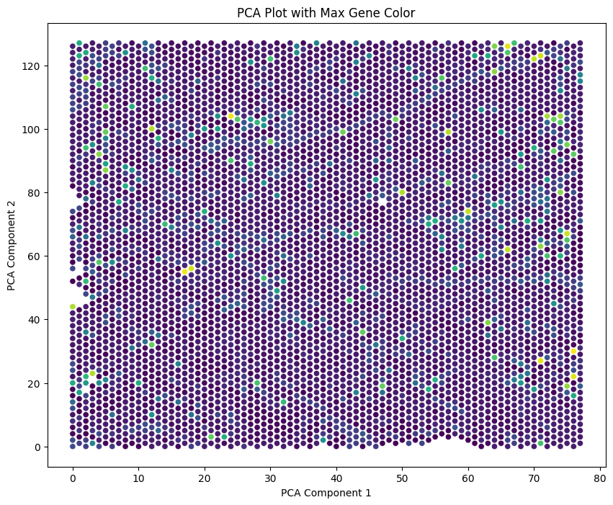
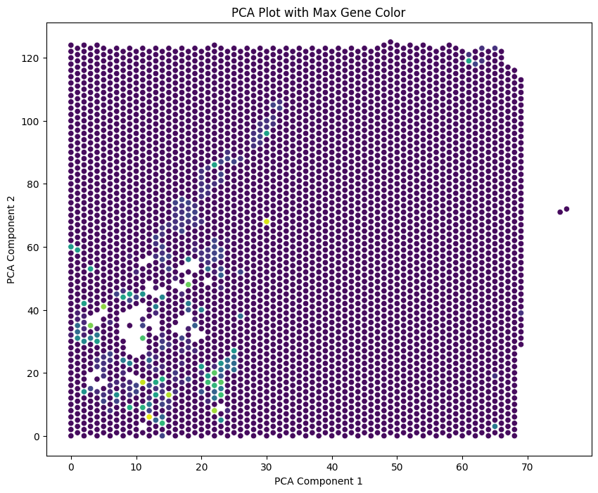
Classification Using Aggregation

Slide 4
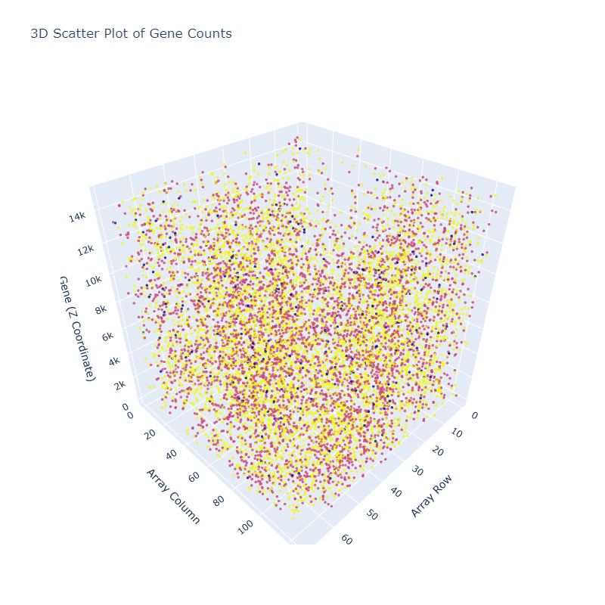
High-Dimensionality and noise

Slide 5
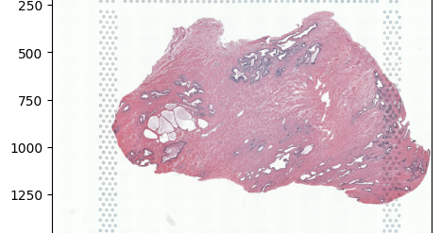
Enter Topological Data Analysis
Extract persistent topological features to allow for computer aided classification
Find structures within the tissue sample to find irregularities and possibly segment the data

Slide 6
How to Visualize?

Slide 7
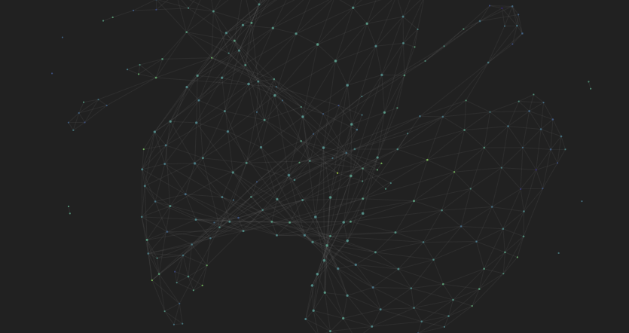
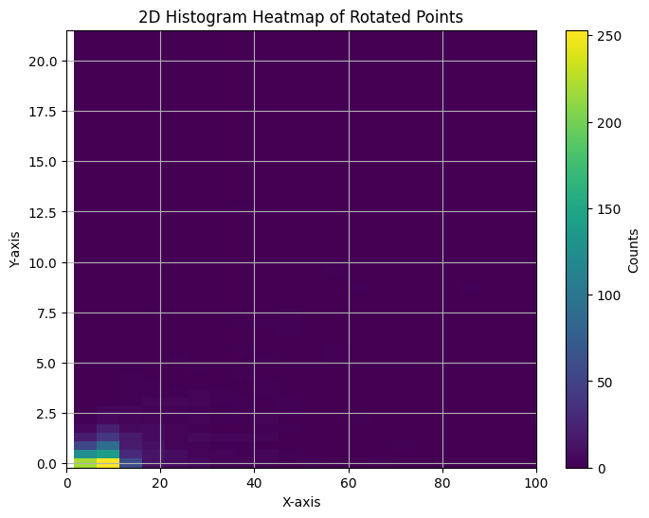
Heatmaps and Interactive Graphs

Slide 8
Methods and Analysis

Slide 9
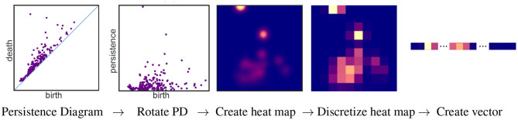
Creating A Heatmap
Create a Persistence Chart
Rotate to provide a more intuitive visualization
Discretize for feature extraction and easier dissemination

Slide 10
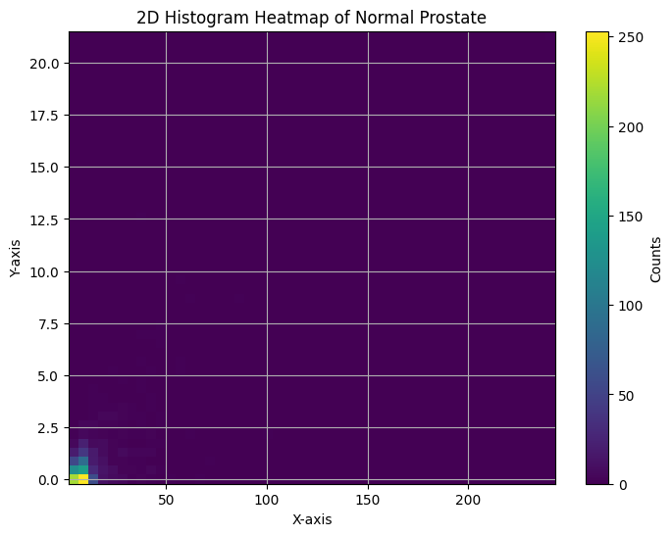
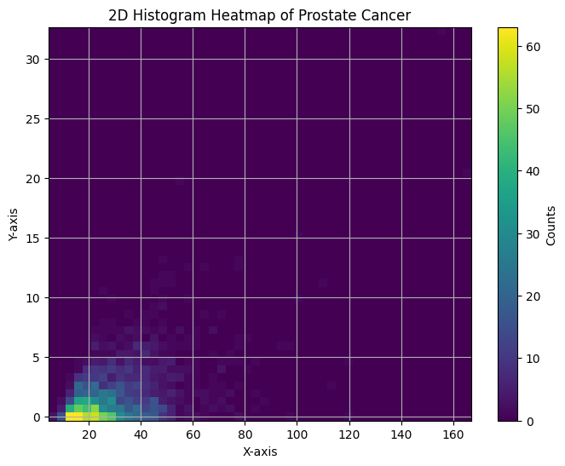
Where it Works
Similar Tissue sizes
Similar Tissue types
Normal Prostate Tissue
Cancerous Prostate Tissue

Slide 11
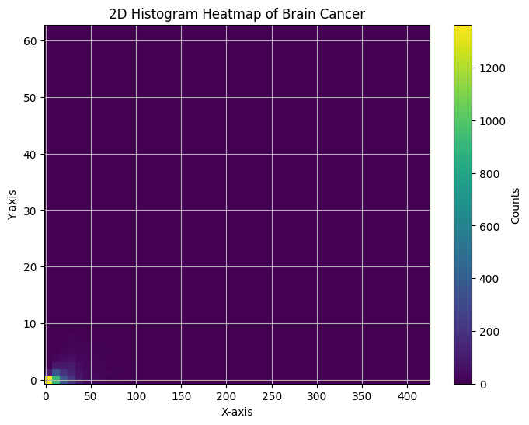
Where it Does Not
Comparing between Small and Large Data Sets
Tissues of Different types
Normal Prostate Tissue
Very Large Sample of Brain Cancer

Slide 12
Why Does it Fail?
High Count of Points concentrated in a small area
Missing large variance due to spread over large area

Slide 13
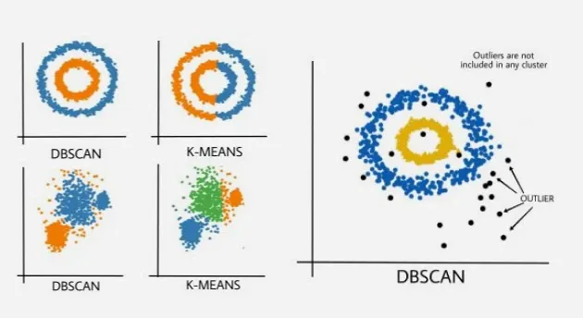
Using Graphs And Clusters instead
Less prone to distribution bias by counting connected components
Use of Density-Based Spatial Clustering of Applications with Noise (DBSCAN)

Slide 14
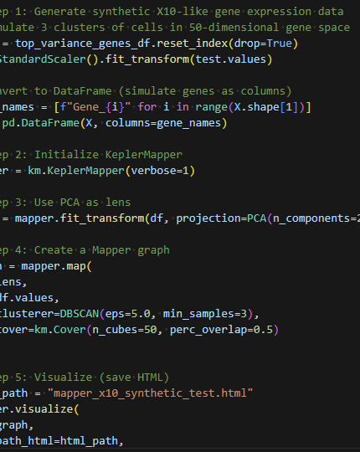
How To make IT?
Using kmapper Python module
Use PCA to reduce runtimes but keep most variable data
DBSCAN to cluster and link the data points
Visualize using the built-in html creator

Slide 15
Does it Address the shortfalls of Persistent TDA
Very Robust to Large Data
It’s a Graph so Features such as edge count, node, count, and connected graphs are readily available
Visualization is intuitive with most significant feature for classification being number of connected components

Slide 16
Explore the Graphs:
https://krazykats.github.io/TDA_cancer

Slide 17
Conclusion
TDA is a very useful tool in the dawn of high dimensional data where geometry is not easily inferred from visual diagrams and thus new methods of feature and visualization found in TDA will be more widespread.

